Slide 1

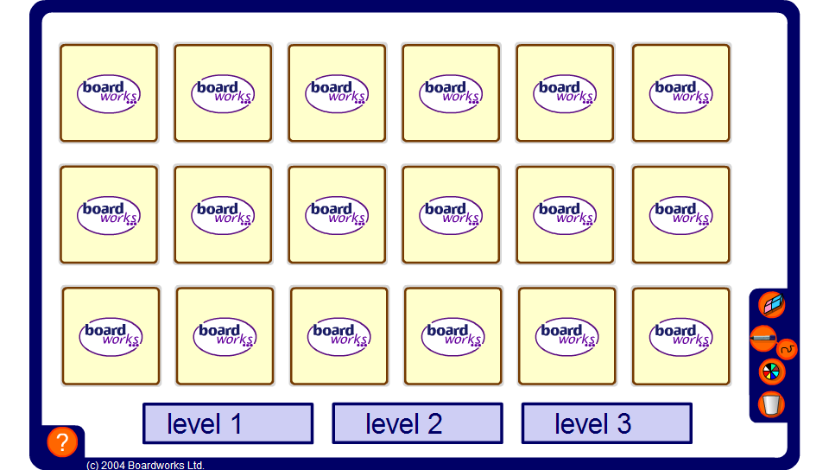


Pelmanism – Fractions and decimals
Notes:
The aim of this activity is to revise the fraction to decimal equivalents that pupils should already be aware of.
Select pupils to come to the board in turns. They must turn over 2 cards. The object is to match cards showing equivalent fractions and decimals.

